Slide 1



Ensuring safe, stable, & nurturing Childhoods for All our Children “taking legislative & policy actions to prevent child sexual abuse: state efforts”
Rush Russell
Executive Director, PCA-NJ
Claudia Remington, jd
Executive Director,
md sccan

Slide 2


STATE LAWS to prevent child sexual abuse
5 KEY LAWS:
CHILD SEXUAL ABUSE TASK FORCE
CHILD SEXUAL ABUSE PREVENTION EDUCATION IN SCHOOLS
ADDRESSING SEXUAL MISCONDUCT & ABUSE IN SCHOOLS – VETTING EMPLOYEES
(S.E.S.A.M.E. or “PASS THE TRASH”)
ERIN’S LAW
CIVIL STATUTE OF LIMITATIONS - with “WINDOW OF JUSTICE” or
“LOOK BACK WINDOW”: “HIDDEN PREDATOR ACT”

Slide 3
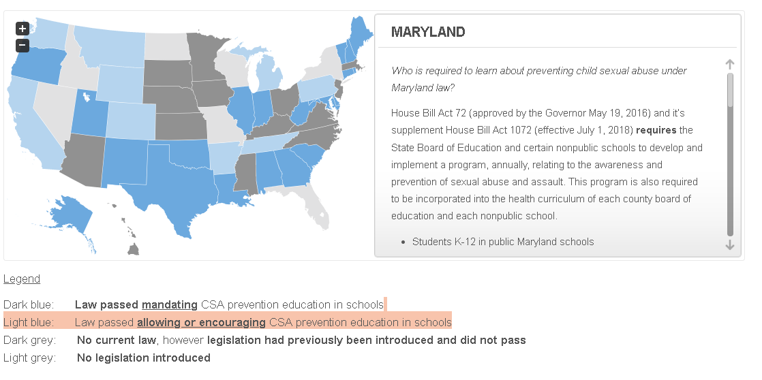
STATE LAWS mandating or allowing child sexual abuse education in schools
21 States mandate CSA Prevention Education in schools
8 States “encourage” the education.
21 states have introduced bills that have failed, or have never introduced a bill

Slide 4
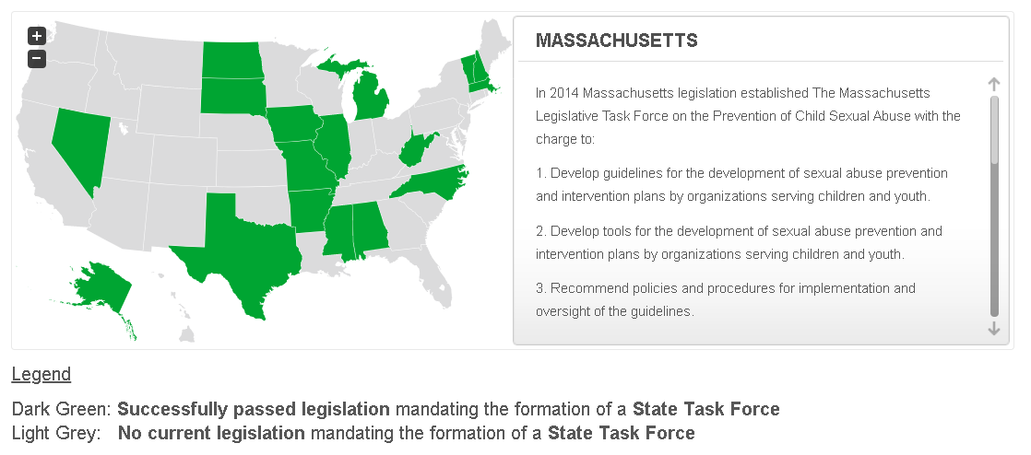
STATE LAWS mandating task force on child sexual abuse
17 States have passed laws to establish state task forces, commissions, or study committees to explore child sexual abuse prevention policies and make recommendations for future action.

Slide 5
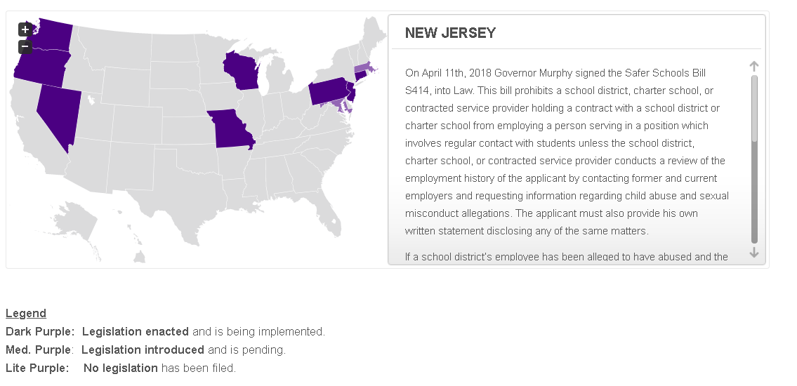
STATE LAWS addressing school employee sexual misconduct & abuse
8 States have enacted laws prohibiting the aiding and abetting of a school employee engaged in sexual misconduct to secure employment in another school.

Slide 6

STATE LAWS mandating or encouraging child sexual abuse education for students: “ERIN’s LAW”
29 States as of September 2018 have passed laws mandating or encouraging schools to teach students:
Body safety
To speak up & tell if they are being abused.
Concerns:
Focus on Child vs. Adult Responsibility for Preventing Child Sexual Abuse
Timing vis a vis Legislation focusing on Adult Responsibility

Slide 7
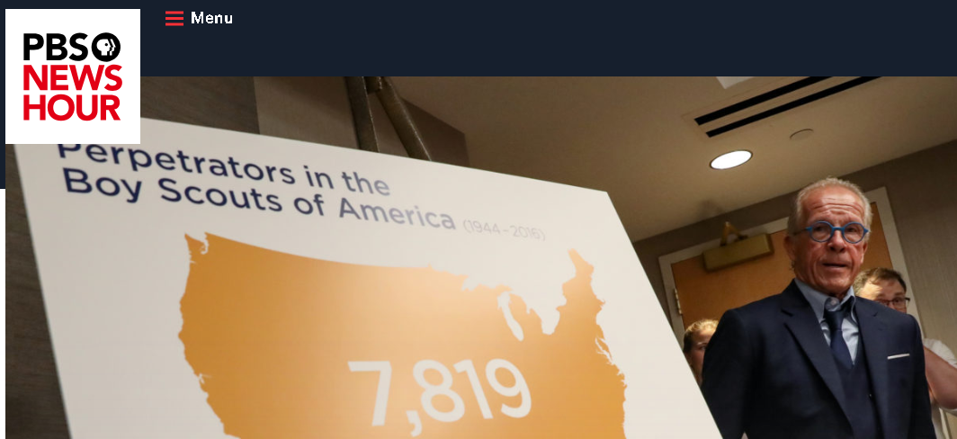

STATE statutes of limitations with WINDOws of justice: hidden predator acts
Windows of Justice Serve 3 Goals:
Identify Hidden Child Predators
Shift the Cost of Abuse from the Victims to the Ones Who Caused It.
Educate the Public & Prevent Future Abuse
https://www.childusa.org/sol

Slide 8
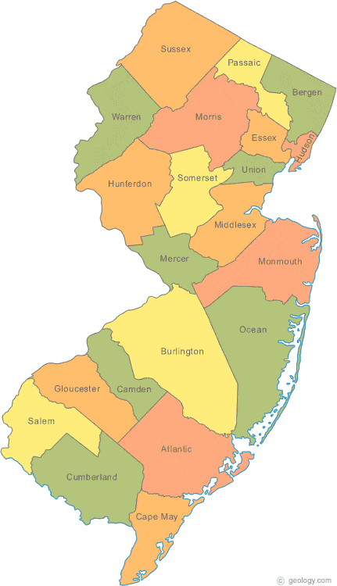
History of NJ Efforts to prevent on Child Sexual Abuse
Internal White Paper/Recommendations
2011-2016 Ms. Foundation for Women Collaboration
Replicate Enough Abuse Campaign – 6 counties
Created NJ Partnership to Prevent Child Sexual Abuse
Created NJ Safe Child Standards – Endorsed by NJ-DCF

Slide 9
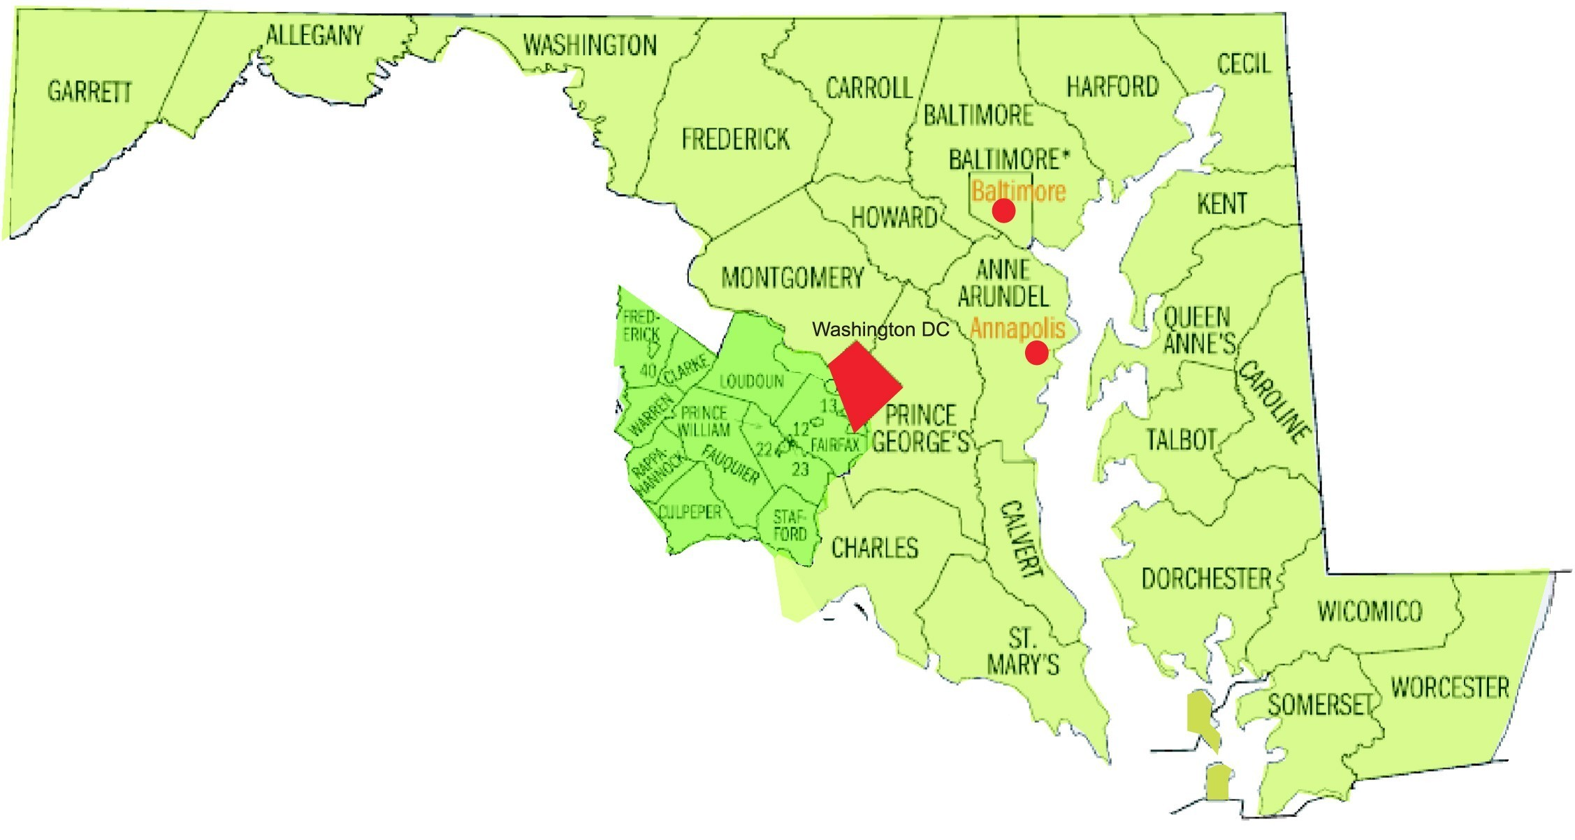
History of MD Efforts to prevent on Child Sexual Abuse
2011-2016 Enough Abuse Campaign & Ms. Foundation for Women Collaboration
2014 MD Essentials for Childhood Initiative
2015 SCCAN Recommendations for Comprehensive CSA Prevention Legislation
2016 Response to MD Erin’s Law
2017 Legislative Champion Identified
2018 -HB 1072 (Education) & HB 1571(SESAME) Introduced
2018 HB 1072 Passed
2019 SESAME Re-Introduced & Passed
2019 SOL Elimination & Window of Justice Introduced
2019 Guidelines for Assessment & Modification of Physical Facilities/Spaces to Reduce CSA

Slide 10

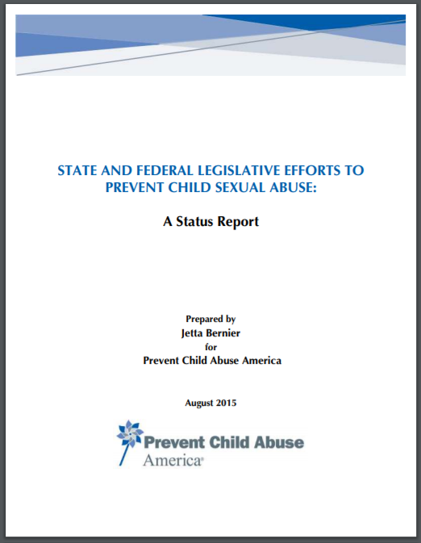
Elements in strategy – Lessons learned
Build a Statewide Coalition to Prevent Child Sexual Abuse
Research:
Best Practices in Primary Prevention
Legislative Success of CSA Prevention Nationwide
Legislative History of CSA Legislation in Your State
Develop Legislative Recommendations

Slide 11

Elements in strategy – Lessons learned
Develop Legislative Recommendations
Annual Report Recommendation:
Adopt policies to prevent child sexual abuse in schools & child serving organizations

Slide 12
Elements in strategy – Lessons learned
Clear statement of need for primary prevention (VT Act One, Michigan Task force Report Goal 1)
Clear focus on adult responsibility for prevention (all adults in schools & YSOs and parents)
Mandated education – public & private schools, youth-serving organizations
Educate adults first; ALL adults, not just teachers; Provide resources for parents regarding talking to children about CSA
Establish & implement policies that support the prevention of & response to sexual abuse via training, screening, & codes of conduct
Eliminate “passing the trash” (PA, MO, MA, NJ “SESAME” acts)

Slide 13
Elements in strategy – Lessons learned
Provide developmentally appropriate instruction for children & youth K-12 on healthy socio emotional development, healthy relationships, sexuality education, focused ‘boundary’ education to reduce child-on-child behaviors, knowledge of rules (e.g. school rules) and laws (e.g. age of consent)
Provide evidence-based treatment for youth with child sexual behavior problems (NC Task Force Report, MA legislation)
Include CSA prevention & intervention training in educator preparatory curricula (New Mexico)
Provide a mechanism to evaluate adult behavior change and change in the incidence of CSA

Slide 14
Elements in strategy – Lessons learned
Goals for Adult Education
Recognize sexually offending behavior in adults, & signs in adults that might indicate they pose a sexual risk to children
Recognize the difference between normative & non-normative child-on-child sexual behavior; appropriately respond to & prevent behavior
Recognize behaviors that might indicate child/youth has been a victim
Support healthy development of students by building protective factors
Establish & implement policies that support the prevention of & response to sexual abuse via training, screening, & codes of conduct
Respond appropriately to disclosures
Know about resources in the community

Slide 15
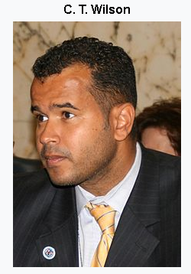

Elements in strategy – Lessons learned
Create an Ongoing CSA Prevention Legislative Workgroup to Push Recommendations Forward
Seek Counsel:
Other States Who’ve Been Successful
National Groups Leading the Issue
Identify a Legislative Champion

Slide 16
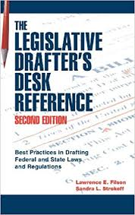
Elements in strategy – Lessons learned
Recruit Legal and/or Drafting Expertise
Draft Legislation
Learn from Other States’ Bills
Incremental or Comprehensive
State Specific

Slide 17
Key provisions of legislation mandating child sexual abuse education in schools:
KEY PROVISIONS OF Maryland’s House Bill 1072
CLEAR FOCUS: PRIMARY PREVENTION & ADULT RESPONSIBILITY (adults first, all adults)
Definitions:
Child Sexual Abuse
Sexual Misconduct
Requires County Boards & Non-Public Schools receiving public funds to provide instruction annually to all employees on the prevention, identification and reporting of child sexual abuse, that will provide them with the ability to:
Recognize sexually misconduct in adults.
Recognize and appropriately respond to sexually inappropriate, coercive, or abusive behaviors among minors.
Recognize behaviors and verbal cues that could indicate a minor has been the victim of child sexual abuse.
Respond to disclosures by minors or their parents or guardians of child sexual abuse or reports of boundary-violating behaviors of adults and minors in a supportive and appropriate manner that meets mandatory reporting requirements under state law.

Slide 18
Key provisions of legislation mandating child sexual abuse education in schools:
KEY PROVISIONS OF House Bill 1072
Requires County Boards to establish policies that support the prevention of child sexual abuse through ongoing staff training regarding:
Behavior that constitutes adult perpetration;
Reporting obligations and procedures;
For staff involved in the hiring process, comprehensive screening of prospective employees;
Requires County Boards to establish Employee Codes of Conduct that address appropriate contact between staff and students.

Slide 19
Key provisions of S.E.S.A.M.E. Or ”pass the trash” Legislation:
GOAL: Establish rules for vetting school employees and keeping school personnel credibly accused of sexual abuse or sexual misconduct out of schools.
Who does the legislation apply to?
Any applicant applying for a position involving direct contact with minors
All public and non-public schools and their contracting agencies.

Slide 20
Key provisions of S.E.S.A.M.E. Or ”pass the trash” Legislation:
Requires all applicants be asked 3 screening questions:
Have you ever been the subject of a sexual abuse or sexual misconduct investigation by any employer, state licensing agency, law enforcement agency or child protective services agency (unless the investigation resulted in a finding that the allegations were false)?
Have you ever been disciplined, discharged, non-renewed, asked to resign while allegations of sexual abuse or sexual misconduct were pending or under investigation or due to findings of abuse or sexual misconduct?
Have you ever had a license, professional license or certificate suspended, surrendered or revoked while allegations were pending or under investigation or due to findings of sexual abuse or sexual misconduct?

Slide 21
Key provisions of S.E.S.A.M.E. Or ”pass the trash” Legislation:
Requires written release from applicant to allow disclosure by previous employers.
Requires the prospective employer to contact all former school employers, and employers where the applicant had direct contact with minors.
Requires the former employers to complete the screening questions regarding the applicant.
Provides immunity from civil and criminal liability to former and current employers for providing information or records, including personnel records, in good faith.

Slide 22
Key provisions of S.E.S.A.M.E. Or ”pass the trash” Legislation:
Bans schools from entering into any collective bargaining agreement, employment contract, resignation, or severance agreement, that has the effect of:
suppressing information about sexual abuse or misconduct by a current or former employee
affecting ability of school to report to authorities
requiring expungement of information regarding allegations or findings of sexual abuse or misconduct from any school documents.

Slide 23
Key provisions of S.E.S.A.M.E. Or ”pass the trash” Legislation:
Meets Every Student Succeeds Act (ESSA) (SEC. 8038) requirements (signed into law in December 2016) that now prohibit a state, state education department or LEA that receives Federal education funds, from “aiding and abetting any employee in obtaining a new job if they know or have probable cause to believe, that such school employee engaged in sexual misconduct involving a minor or student”.
ESSA requires states to adopt laws, policies, and regulations to prohibit the practice.

Slide 24
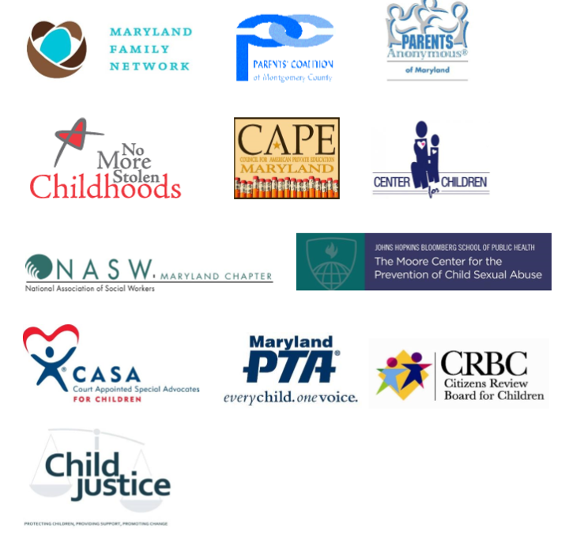


Elements in strategy – Lessons learned
Build a Bill Specific Coalition

Slide 25




Elements in strategy – Lessons learned
Know Your Opponents & Work With Them (turn them into allies), if possible
Develop a Legislative Packet for Key Committees’ Members

Slide 26

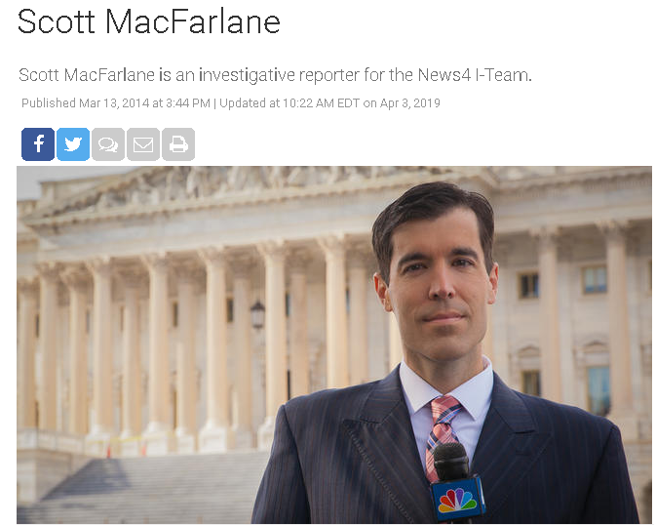
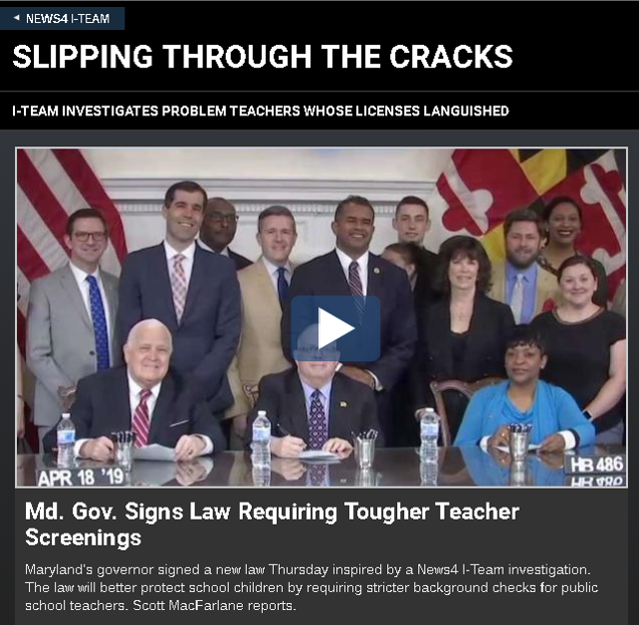



Elements in strategy – Lessons learned
Engage the Media

Slide 27


Elements in strategy – Lessons learned
Develop a Social Media Campaign & Toolkit

Slide 28
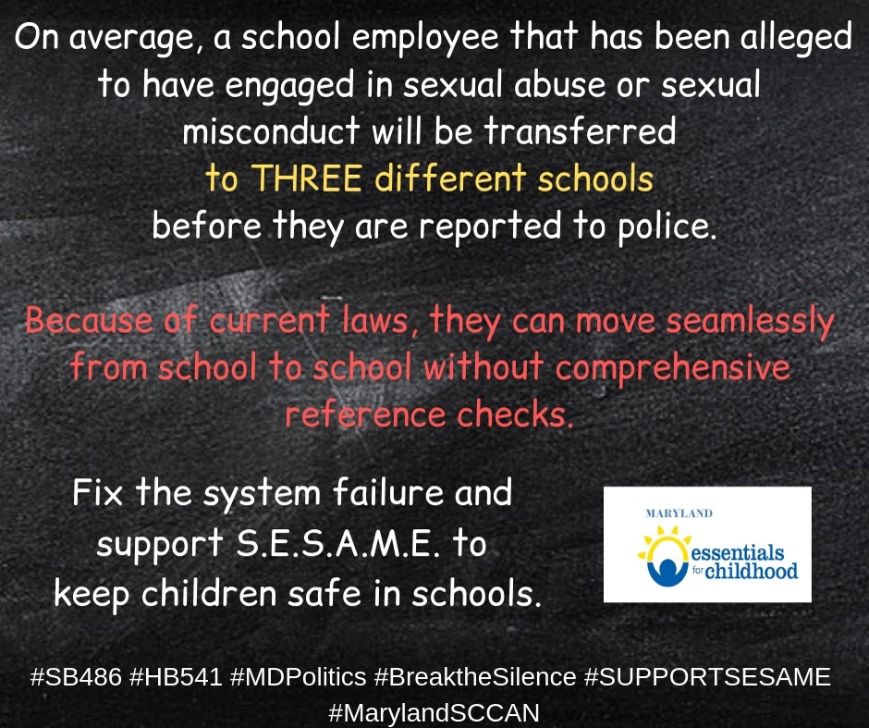
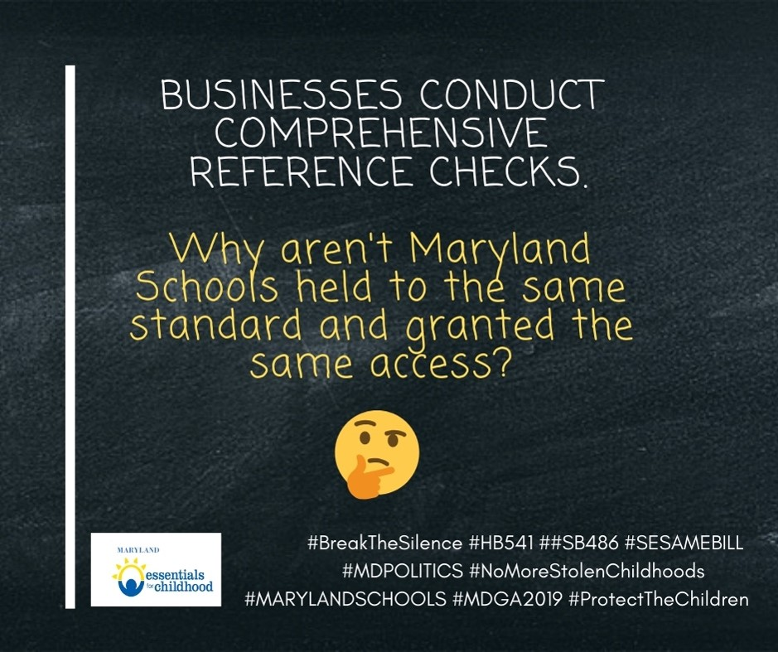
Elements in strategy – Lessons learned

Slide 29

Elements in strategy Lessons learned
Educate Coalition Members on the Bill Specifics (including arguments for & against)
Prepare Talking Points
Prepare FAQ’s
Research & Prepare Your State’s Case Examples

Slide 30
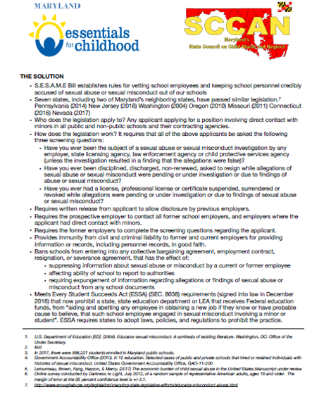
Elements in strategy Lessons learned
Educate Coalition Members on the Bill Specifics (including arguments for & against)
Prepare Talking Points
Prepare FAQ’s
Research & Prepare Your State’s Case Examples

Slide 31
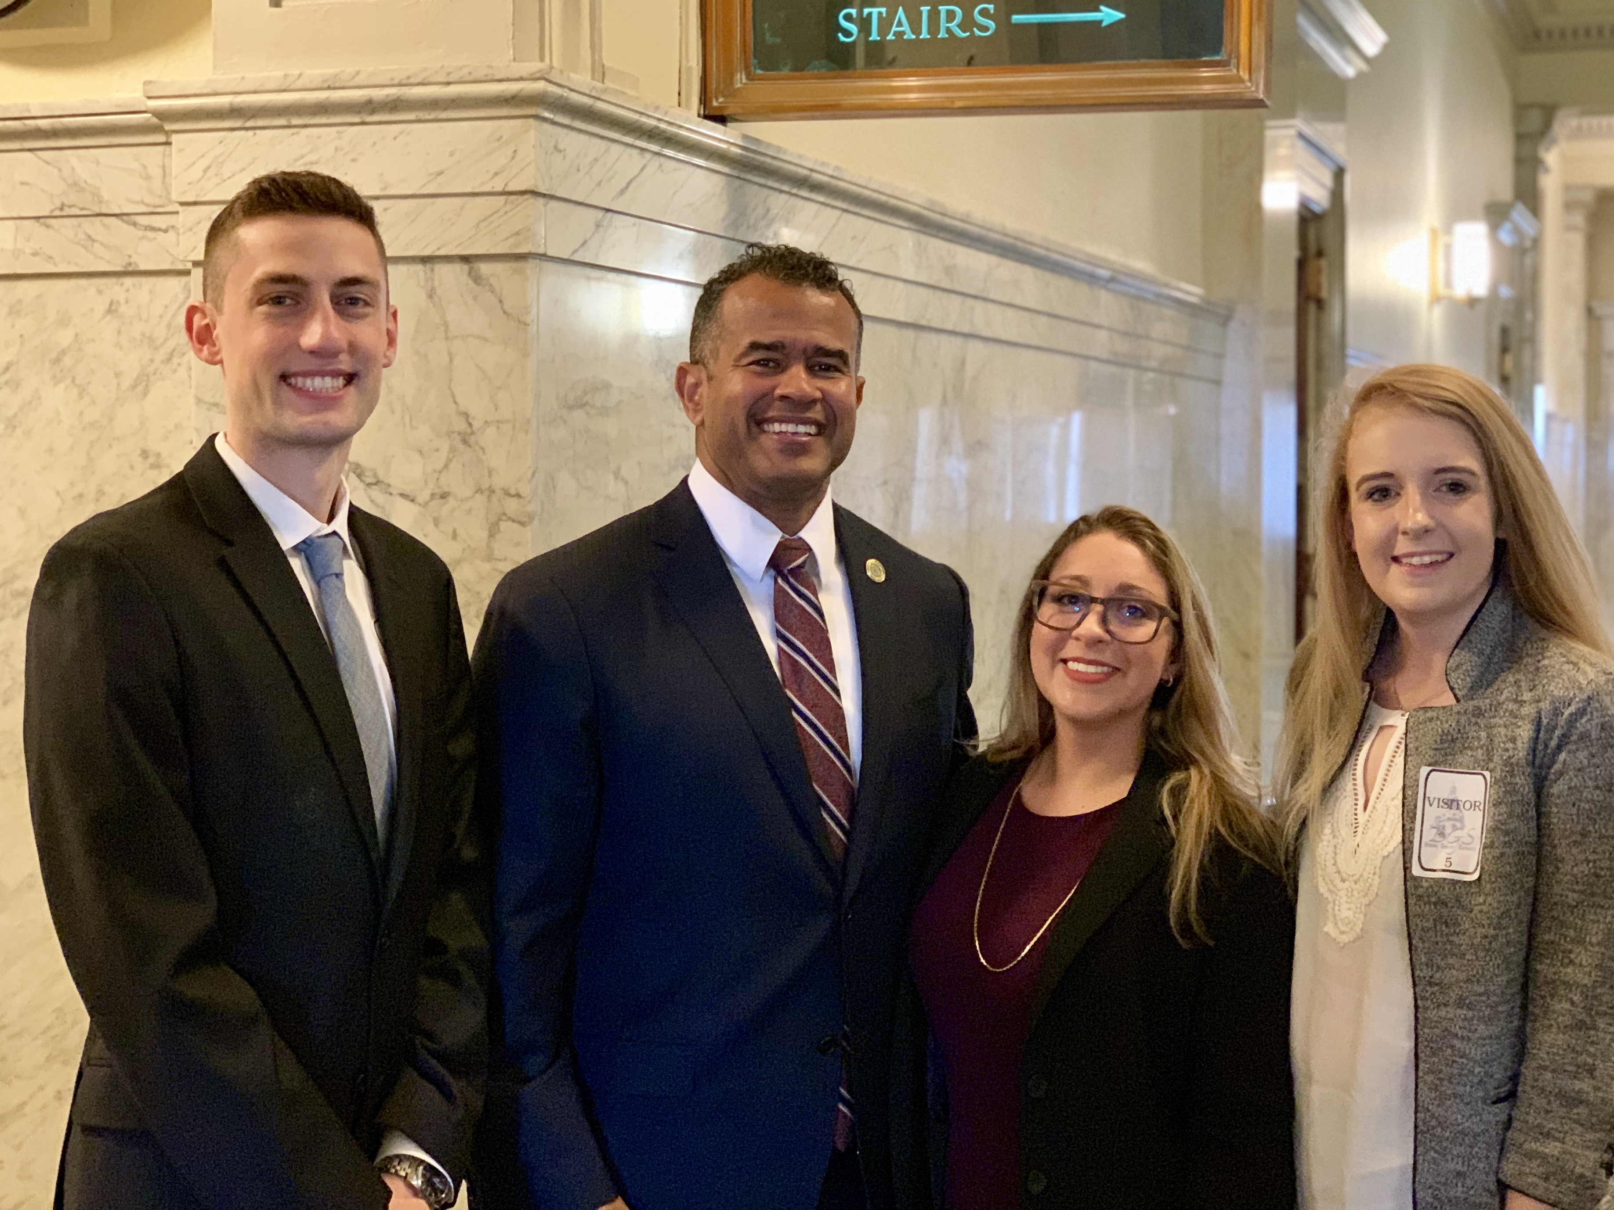
Elements in strategy Lessons learned
Educate Coalition Members on the Bill Specifics (including arguments for & against)
Prepare Talking Points
Prepare FAQ’s
Research & Prepare Your State’s Case Examples

Slide 32
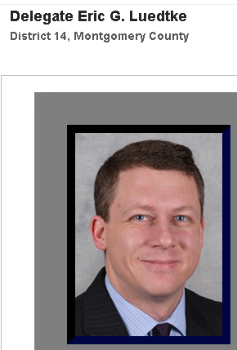
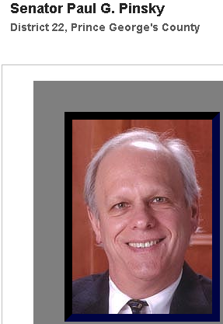
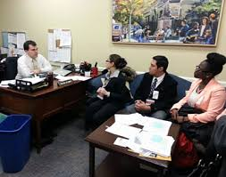
Elements in strategy – Lessons learned
Know the Members of the Key Committees
Who are the Committee Chairs?
Who’s likely to be FOR, AGAINST, UNDECIDED?
Acknowledge the bipartisan nature of the bill
Schedule Office Visits with Committee Members and/or Staff

Slide 33
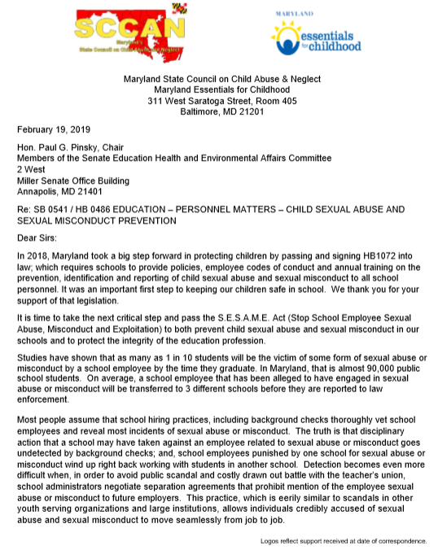
Elements in strategy – Lessons learned
Develop Strategic Oral & Written Testimony in Support of the Bill
Draft a Joint Letter from Bill-Specific Coalition Members

Slide 34
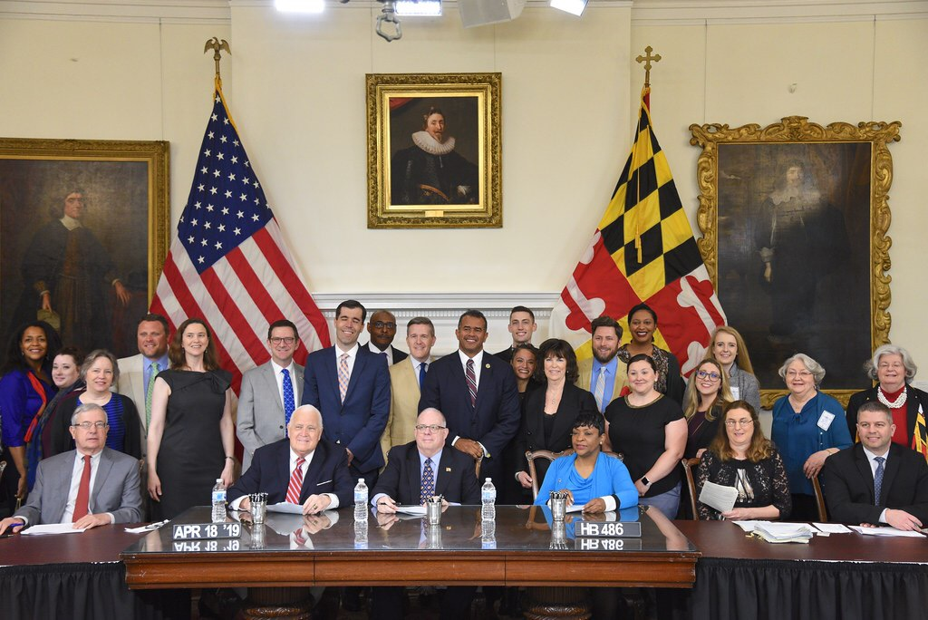
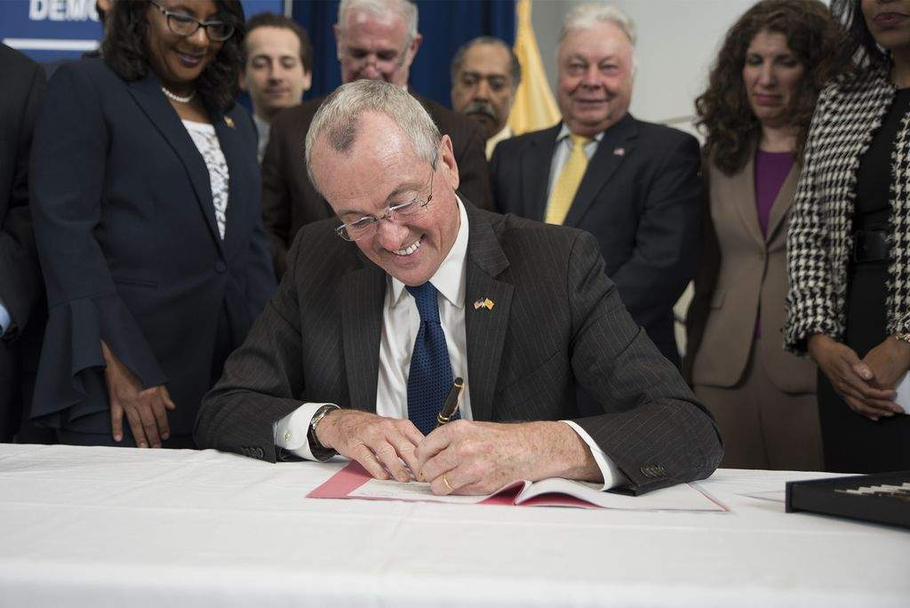
Elements in strategy – Lessons learned
Monitor the Bill through Passage & Governor’s Signature
CELEBRATE!

Slide 35


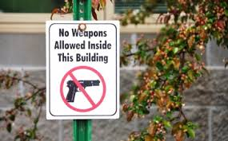


Elements in strategy – Lessons learned
Follow Up on Implementation
IMPLEMENTATION ISSUES
SCHOOL ASSESSMENT & MODIFICATION OF PHYSICAL FACILITIES & SPACES
GUIDELINES & BEST PRACTICES
Competing Concerns
for Schools

Slide 36
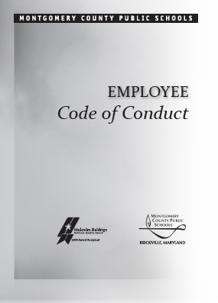

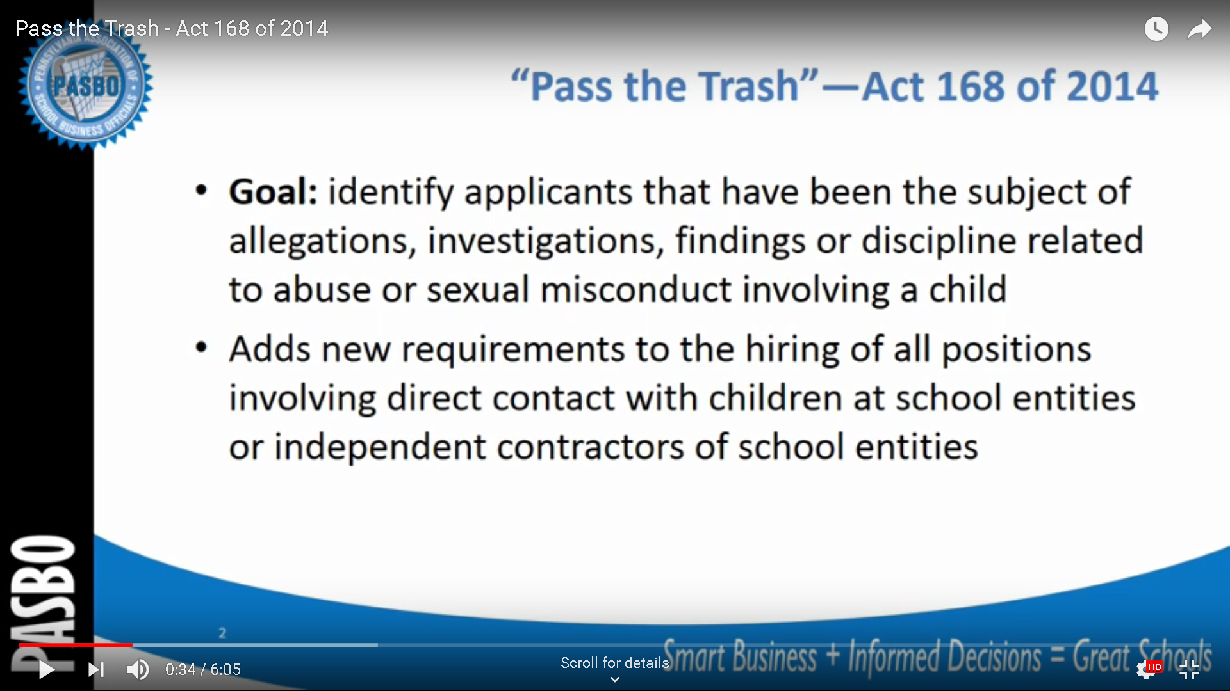
Elements in strategy – Lessons learned
Follow Up on Implementation
Employee CSA Prevention Training
Employee Codes of Conduct
CSA Policies
Development of S.E.S.A.M.E. Application
Monitoring of Use of Application

Slide 37

Thank you!
Rush Russell
Executive Director, Prevent Child Abuse NJ
Rrussell@preventchildabusenj.org
732-246-8060
Claudia Remington
Executive Director, MD State Council on Child Abuse & Neglect
Claudia.Remington@Maryland.Gov
240-506-3050

